Slide 1
Reasoning with Uncertainty

Slide 2
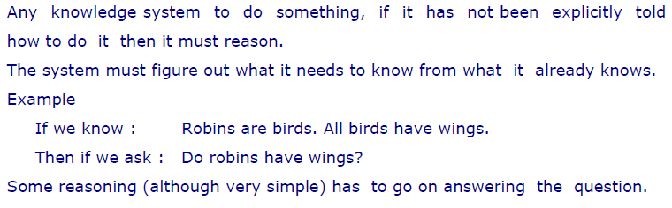
Reasoning

Slide 3
Reasoning
How can we reason?
To a certain extent this will depend on the knowledge representation chosen. Although a good knowledge representation scheme has to allow easy, natural and plausible reasoning. Listed below are very broad methods of how we may reason.

Slide 4
Types of Reasoning
Formal reasoning
-- Basic rules of inference with logic knowledge representations.
Procedural reasoning
-- Uses procedures that specify how to perhaps solve (sub) problems.
Reasoning by analogy
-- Humans are good at this, more difficult for AI systems. E.g. If we are asked Can robins fly?. The system might reason that robins are like sparrows and it knows sparrows can fly so ...
Generalisation and abstraction
-- Again humans effective at this. This is basically getting towards learning and understanding methods.
Meta-level reasoning
-- Once again uses knowledge about about what you know and perhaps ordering it in some kind of importance.

Slide 5
Uncertain Reasoning?
Unfortunately the world is an uncertain place.
Any AI system that seeks to model and reasoning in such a world must be able to deal with this.
In particular it must be able to deal with:
• Incompleteness -- compensate for lack of knowledge.
• Inconsistencies -- resolve ambiguities and contradictions.
• Change -- it must be able to update its world knowledge base over time.
Clearly in order to deal with this some decision that a made are more likely to be true (or false) than others and we must introduce methods that can cope with this uncertainty.
There are three basic methods that can do this:
• Symbolic methods.
• Statistical methods.
• Fuzzy logic methods.

Slide 6
Sources of uncertainty
Uncertain inputs
  Missing data
  Noisy data
Uncertain knowledge
  Multiple causes lead to multiple effects
  Incomplete enumeration of conditions or effects
  Incomplete knowledge of causality in the domain
  Probabilistic/stochastic effects
Uncertain outputs
  Abduction and induction are inherently uncertain
  Default reasoning, even in deductive fashion, is uncertain
  Incomplete deductive inference may be uncertain
Probabilistic reasoning only gives probabilistic results (summarizes uncertainty from various sources)

Slide 7
Why Reason Probabilistically?
In many problem domains it isn't possible to create complete, consistent models of the world. Therefore agents (and people) must act in uncertain worlds (which the real world is).
Want an agent to make rational decisions even when there is not enough information to prove that an action will work.
Some of the reasons for reasoning under uncertainty:
  True uncertainty. E.g., flipping a coin.
  Theoretical ignorance. There is no complete theory which is known about the problem domain. E.g., medical diagnosis.
  Laziness. The space of relevant factors is very large, and would require too much work to list the complete set of antecedents and consequents. Furthermore, it would be too hard to use the enormous rules that resulted.
  Practical ignorance. Uncertain about a particular individual in the domain because all of the information necessary for that individual has not been collected.
Probability theory will serve as the formal language for representing and reasoning with uncertain knowledge.

Slide 8
Representing Belief about Propositions
Rather than reasoning about the truth or falsity of a proposition, reason about the belief that a proposition or event is true or false
For each primitive proposition or event, attach a degree of belief to the sentence
Use probability theory as a formal means of manipulating degrees of belief
Given a proposition, A, assign a probability, P(A), such that 0 <= P(A) <= 1, where if A is true, P(A)=1, and if A is false, P(A)=0. Proposition A must be either true or false, but P(A) summarizes our degree of belief in A being true/false.
Examples
  P(Weather=Sunny) = 0.7 means that we believe that the weather will be Sunny with 70% certainty. In this case Weather is a random variable that can take on values in a domain such as {Sunny, Rainy, Snowy, Cloudy}.
  P(Cavity=True) = 0.05 means that we believe there is a 5% chance that a person has a cavity. Cavity is a Boolean random variable since it can take on possible values True and False.
  Example: P(A=a ^ B=b) = P(A=a, B=b) = 0.2, where A=My_Mood, a=happy, B=Weather, and b=rainy, means that there is a 20% chance that when it's raining my mood is happy.

Slide 9
Obtaining and Interpreting Probabilities
There are several senses in which probabilities can be obtained and interpreted among them the following:
Frequentist Interpretation
The probability is a property of a population of similar events. E.g., if set S = P union N, and P intersection N is the empty set, then the probability of an object being in set P is |P|/|S|. Hence, in this interpretation probabilities come from experiments and determining the population associated with a given proposition.
Subjectivist Interpretation
A subjective degree of belief in a proposition or the occurrence of an event. E.g., the probability that you'll pass the Final Exam based on your own subjective evaluation of the amount of studying you've done and your understanding of the material. Hence, in this interpretation probabilities characterize the agent's beliefs.

Slide 10
Classical interpretation of probability
It is based on the concept of equally likely outcomes. If outcome of some process must be one of n different outcomes and if these outcomes are equally likely to occur.

Slide 11
Probabilistic Reasoning
Using logic to represent and reason we can represent knowledge about the world with
facts and rules, like the following ones:
bird(tweety).
fly(X) :- bird(X).
We can also use a theorem-prover to reason about the world and deduct new facts about
the world, for e.g.,
?- fly(tweety).
Yes
However, this often does not work outside of toy domains - non-tautologous certain rules are hard to find.
Defn: A way to handle knowledge representation in real problems is to extend logic by using certainty factors.

Slide 12
In other words, replace
IF condition THEN fact
with
IF condition with certainty x THEN fact with certainty f(x)
Unfortunately cannot really adapt logical inference to probabilistic inference, since the
latter is not context-free.
Replacing rules with conditional probabilities makes inferencing simpler.
Replace
smoking -> lung cancer
or
lotsofconditions, smoking -> lung cancer
with
P(lung cancer | smoking) = 0.6

Slide 13
Uncertainty is represented explicitly and quantitatively within probability theory, a formalism that has been developed over centuries.
A probabilistic model describes the world in terms of a set S of possible states – the sample space. We don’t know the true state of the world, so we (somehow) come up with a probability distribution over S which gives the probability of any state being the true one. The world usually described by a set of variables or attributes.

Slide 14
Consider the probabilistic model of a fictitious medical expert system. The ‘world’ is described by 8 binary valued variables:
Visit to Asia? A
Tuberculosis? T
Either tub. or lung cancer? E
Lung cancer? L
Smoking? S
Bronchitis? B
Dyspnoea? D
Positive X-ray? X
We have 2⁸ = 256 possible states or configurations and so 256 probabilities to find.

Slide 15
We will assume that in a given problem domain, the programmer and expert identify all of the relevant propositional variables that are needed to reason about the domain. Each of these will be represented as a random variable, i.e., a variable that can take on values from a set of mutually exclusive and exhaustive values called the sample space or partition of the random variable. Usually this will mean a sample space {True, False}. For example, the propositionCavity has possible values True and False indicating whether a given patient has a cavity or not. A random variable that has True and False as its possible values is called a Boolean random variable.More generally, propositions can include the equality predicate with random variables and the possible values they can have. For example, we might have a random variable Color with possible values red, green, blue, and other. Then P(Color=red) indicates the likelihood that the color of a given object is red. Similarly, for Boolean random variables we can ask P(A=True), which is abbreviated to P(A), and P(A=False), which is abbreviated to P(~A).

Slide 16
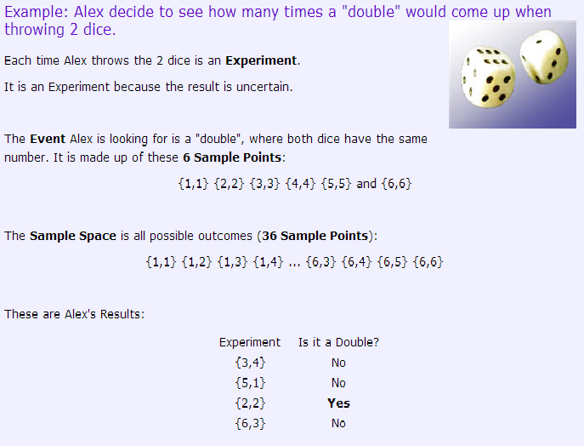

Slide 17
Axioms of Probability Theory
Probability Theory provides us with the formal mechanisms and rules for manipulating propositions represented probabilistically. The following are the three axioms of probability theory:
0 <= P(A=a) <= 1 for all a in sample space of A
P(True)=1, P(False)=0
P(A v B) = P(A) + P(B) - P(A ^ B)
From these axioms we can show the following properties also hold:P(~A) = 1 - P(A)
P(A) = P(A ^ B) + P(A ^ ~B)
Sum{P(A=a)} = 1, where the sum is over all possible values a in the sample space of A

Slide 18
Joint Probability Distribution
Given an application domain in which we have determined a sufficient set of random variables to encode all of the relevant information about that domain, we can completely specify all of the possible probabilistic information by constructing the full joint probability distribution, P(V1=v1, V2=v2, ..., Vn=vn), which assigns probabilities to all possible combinations of values to all random variables.
For example, consider a domain described by three Boolean random variables, Bird, Flier, and Young. Then we can enumerate a table showing all possible interpretations and associated probabilities:

Slide 19
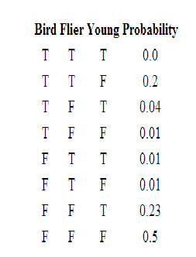
Notice that there are 8 rows in the above table representing the fact that there are 2³ ways to assign values to the three Boolean variables. More generally, withn Boolean variables the table will be of size 2^{n}. And if n variables each had k possible values, then the table would be size k^{n}.
Also notice that the sum of the probabilities in the right column must equal 1 since we know that the set of all possible values for each variable are known. This means that for n Boolean random variables, the table has 2^{n}-1 values that must be determined to completely fill in the table.
If all of the probabilities are known for a full joint probability distribution table, then we can compute any probabilistic statement about the domain. For example, using the table above, we can compute
P(Bird=T) = P(B) = 0.0 + 0.2 + 0.04 + 0.01 = 0.25
P(Bird=T, Flier=F) = P(B, ~F) = P(B, ~F, Y) + F(B, ~F, ~Y) = 0.04 + 0.01 = 0.05

Slide 20
Conditional Probabilities
Conditional probabilities are key for reasoning because they formalize the process of accumulating evidence and updating probabilities based on new evidence. For example, if we know there is a 4% chance of a person having a cavity, we can represent this as the prior (aka unconditional) probability P(Cavity)=0.04. Say that person now has a symptom of a toothache, we'd like to know what is the posterior probability of a Cavity given this new evidence. That is, compute P(Cavity | Toothache).
If P(A|B) = 1, this is equivalent to the sentence in Propositional Logic B => A. Similarly, if P(A|B) =0.9, then this is like saying B => A with 90% certainty. In other words, we've made implication fuzzy because it's not absolutely certain.
Given several measurements and other "evidence", E1, ..., Ek, we will formulate queries as P(Q | E1, E2, ..., Ek) meaning "what is the degree of belief that Q is true given that we know E1, ..., Ek and nothing else."
Conditional probability is defined as: P(A|B) = P(A ^ B)/P(B) = P(A,B)/P(B)
One way of looking at this definition is as a normalized (using P(B)) joint probability (P(A,B)).

Slide 21
Conditional Probabilities
Example Computing Conditional Probability from the Joint Probability Distribution
Say we want to compute P(~Bird | Flier) and we know the full joint probability distribution function given above. We can do this as follows:
P(~B|F) = P(~B,F) / P(F) = (P(~B,F,Y) + P(~B,F,~Y)) / P(F) = (.01 + .01)/P(F) Next, we could either compute the marginal probability P(F) from the full joint probability distribution, or, as is more commonly done, we could do it by using a process called normalization, which first requires computing
P(B|F) = P(B,F) / P(F) = (P(B,F,Y) + P(B,F,~Y)) / P(F) = (0.0 + 0.2)/P(F) Now we also know that P(~B|F) + P(B|F) = 1, so substituting from above and solving for P(F) we get P(F) = 0.22. Hence, P(~B|F) = 0.02/0.22 = 0.091.
A math teacher gave her class two tests. 25% of the class passed both tests and 42% of the class passed the first test. What percent of those who passed the first test also passed the second test?

Slide 22
Bayes's Rule:
P(A|B) = (P(A)P(B|A))/P(B), which can be written as follows to more clearly emphasize the "updating" aspect of the rule: P(A|B) = P(A) * [P(B|A)/P(B)] Note: The terms P(A) and P(B) are called the prior (or marginal) probabilities. The term P(A|B) is called the posterior
Suppose someone told you they had a nice conversation with someone on the train. Not knowing anything else about this conversation, the probability that they were speaking to a woman is 50%. Now suppose they also told you that this person had long hair. It is now more likely they were speaking to a woman, since most long-haired people are women. Bayes' theorem can be used to calculate the probability that the person is a woman.

Slide 23
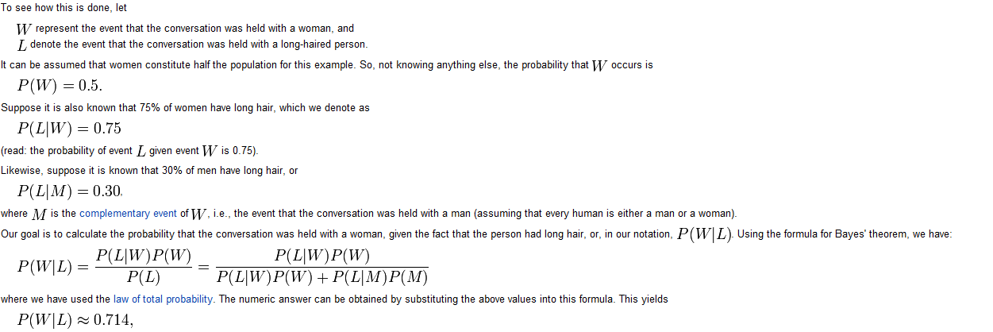
Example

Slide 24
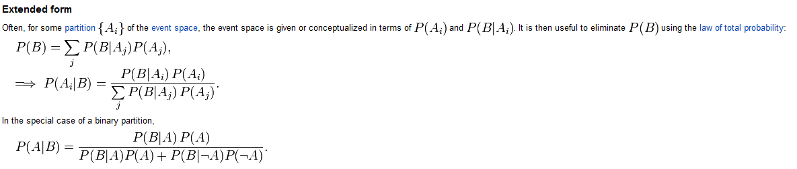
Extended Bayes's Rule:

Slide 25
Interpretation of Bayes Th
Read of your own.

